Slide 1
Bookworms Linkup
Design Thinking Project
Lecturer:
Dr. Azurah ABD Samah
Prepared by:
SECP 1513 (01) Group 4

Slide 2
Table of Contents
01.
02.
Empathy
Define
03.
04.
Ideate
Prototype
Understand the users
Observe, Engage
& Immerse
Solutions to problems
Software application features

Slide 3
01.
Empathy
Observe
View the users’ behaviour in the context of their lives.
Engage
Intact with and interview users.
Immerse
Experience what the users experience.

Slide 4
Empathy Mode ;
observe the everyday lives of university students
Observe
Engage
Immerse
put ourselves in their shoes to better understand their needs
conduct interview with the students

Slide 5
02.
Define
To develop a deep understanding of the users and come up with reasonable problem statements

Slide 6
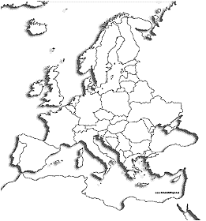
Define Mode ;
Minutes of Reading per day in Europe
Finland 12 min
Poland 12 min
Hungary 10 min
Germany 7 min
UK 6 min
Netherlands 6 min
Belgium 6 min
Spain 6 min
Italy 5 min
Austria 5 min
France 2 min

Slide 7
Define Mode ;
Users’ wants & needs
1. To cultivate reading habits
because book is where knowledge is,
and knowledge is power.
2. To strengthen their cognitive skills
because problem-solving skills,
communication and adaptability
are core elements towards a successful career.
3. To appreciate the habit of reading
because ‘the man who does not read has no
advantage over the man who cannot read.’

Slide 8
03.
Ideate
Explore a wide solution space,
namely a large quantity &
huge diversity of ideas.

Slide 9
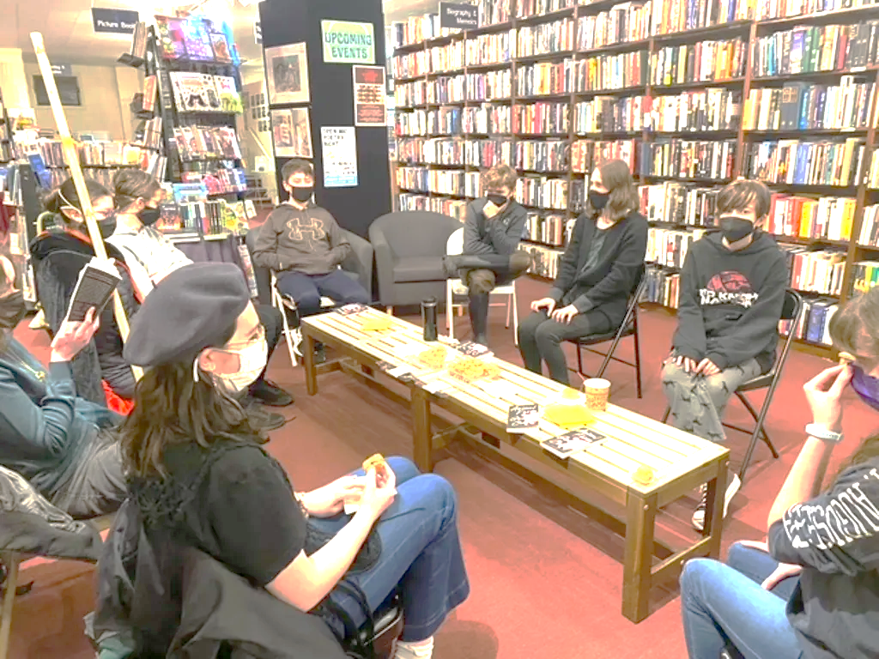

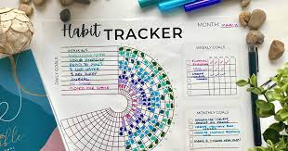
Ideate Mode ;
Solutions 1/3
2.
Form a book club
1.
Form a readers’ community
to share or exchange books.
3.
Design a habit tracking system
to promote reading through group effect.
to help students keep up with their reading habit.

Slide 10

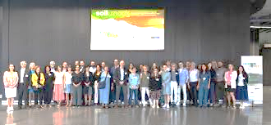
Ideate Mode ;
Solutions 2/3
4.
Organize a reading campaign
5.
Organize forums
to share opinions with the public.
to promote the importance of reading habits.

Slide 11
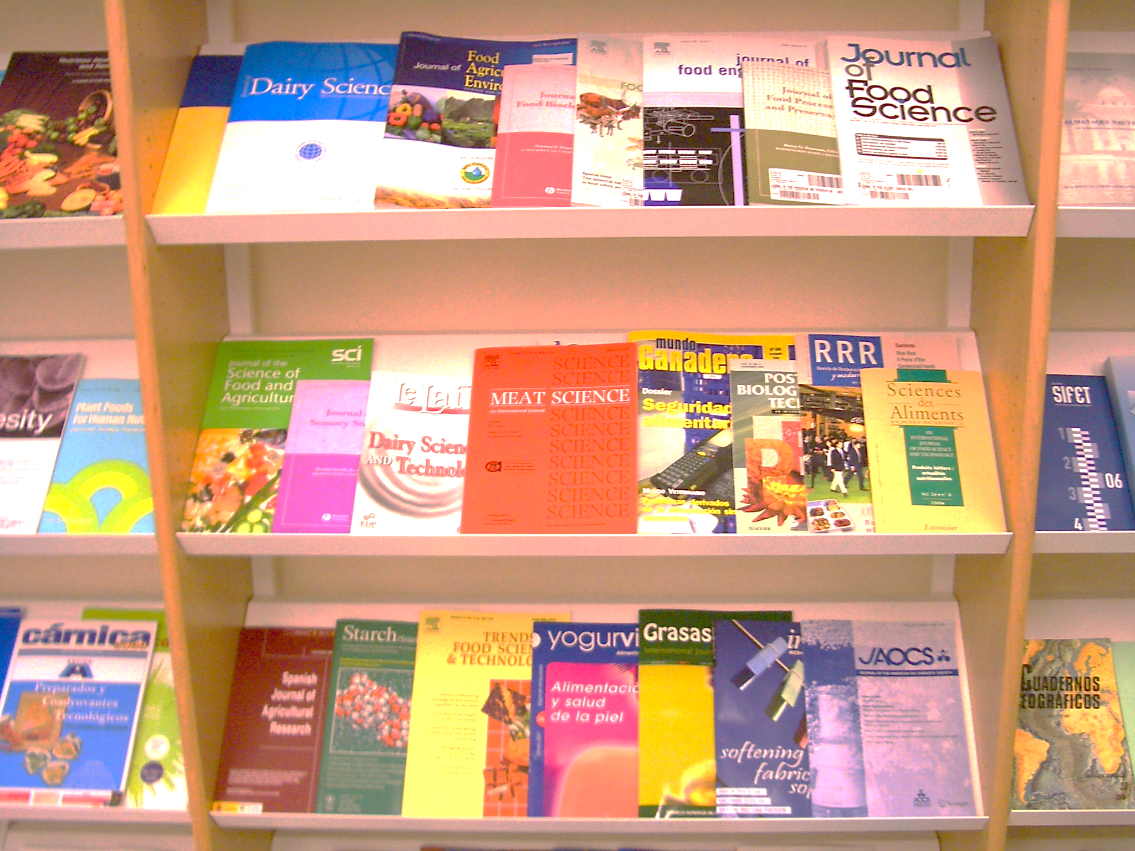
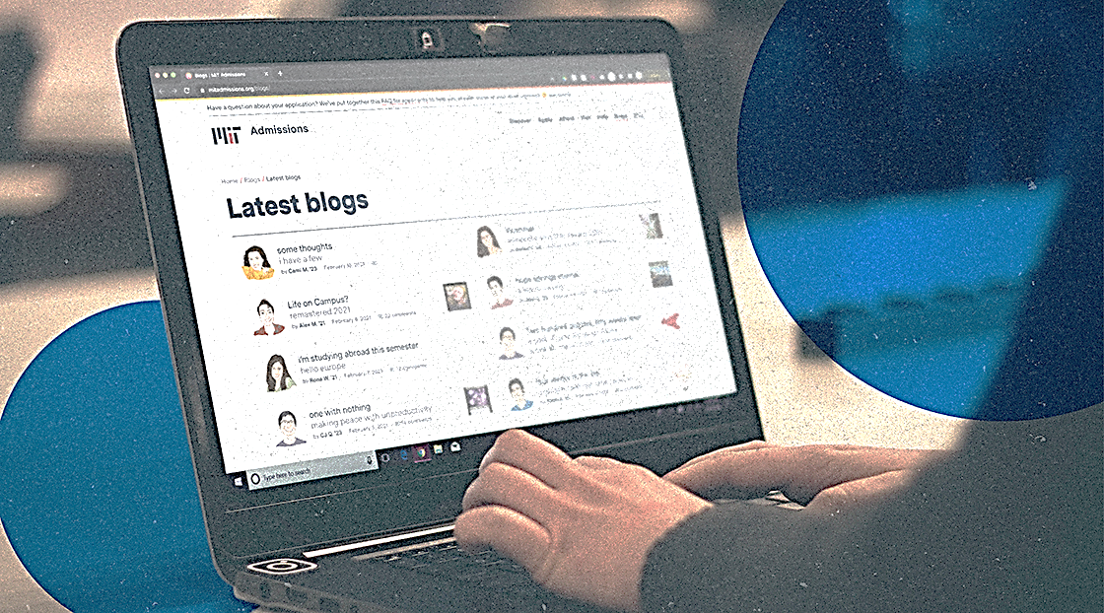
Ideate Mode ;
Solutions 3/3
6.
Start a university journal or magazine
7.
Design a blog
to encourage intellectual discussions.
to share opinions.

Slide 12
Ideate Mode ;
Final idea
To design a
software application
Publish
opinions
Track reading habit
BookwormsLinkup
Form readers’ communities

Slide 13
04.
Prototype
Transform the ideas into tangible form where people can experience and interact with them to drive deeper empathy.

Slide 14
Prototype Mode ;
Apps Features
1. Write & Publish
reviews and quotes
2. Reading challenge
as a habit tracking tool
3. Readers’ communities
connecting people
4. Book suggestion
to expand the horizon

Slide 15
Thanks!
Do you have any questions?
I’m sure ChatGPT can answer it for you! (jk)
We’ll try our best to answer it.

